Slide 1
IRBI Update
Sprout

Slide 2
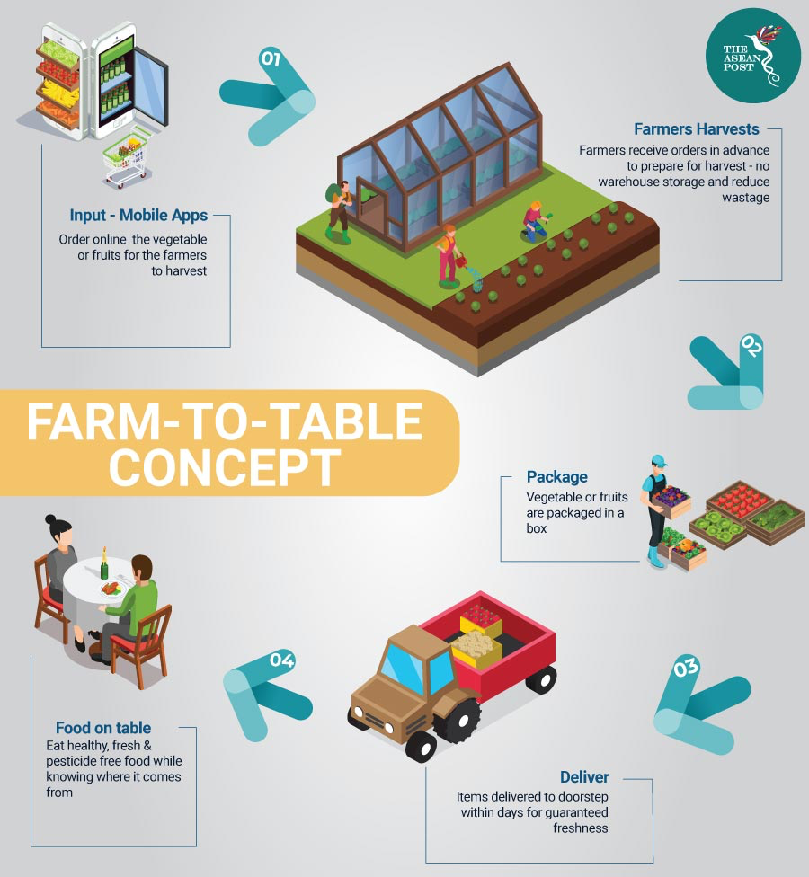
IRBI Update
Notes:
Research link: https://www.researchgate.net/publication/265969293_Consumer_segments_in_organic_foods_market

Slide 3
IRBI Update
Business model:
Weekly delivery of grocery (organic products)
Farming experience
Product
Customizable Baskets
Baby plants -> new organic trend
Client segments
Farmer
In Catalonia area. Catalonia has 2nd biggest amount of manufacturers dedicated to ecological agriculture activity in Spain.
Within 150km from our location (Barcelona)
Farm product: Everything we plan to sell can be found within this region. (Fruits, vegetables, cereals, legumes).
Customer
Based on a research paper, 18-25 year olds are favourable. Also, 25-40 range has bigger income to spend on shopping baskets (families).
Will do a quantitative analysis (survey) to confirm this
Customer income is high. GDP in Catalonia is more than 20% of GDP in Spain.
Logistics
Weekly delivery
Hire/purchase a transport car
No warehouse, directly from the farms to the customers
Notes:
Research link: https://www.researchgate.net/publication/265969293_Consumer_segments_in_organic_foods_market

Slide 4
Progress Report
Competitor Research
Organic Basket Barcelona
El Broquil
Agroboca
Market Segment Research
Contact farmers
Paper research (demographics and attitudes towards environment, health and social)
Customer survey on the way
Positioning strategy: Start as a Niche with specific farms (Differentiated product and experience)
Marketing Plan
Product - Varied basket of seasonal products.
Price - (Work in progress) Compare with competition / Analyze our costs
Promotion - Discounts / Visits / 0 VAT Days
Place - Online / Markets with partnership
Notes:
Link to customer survey: https://docs.google.com/document/d/1euGhCnjm9TCb3qzX5xLx0nGiPuwteTMxZrECELcGoYM/edit
https://www.bcg.com/publications/1970/strategy-the-product-portfolio.aspx

Slide 5
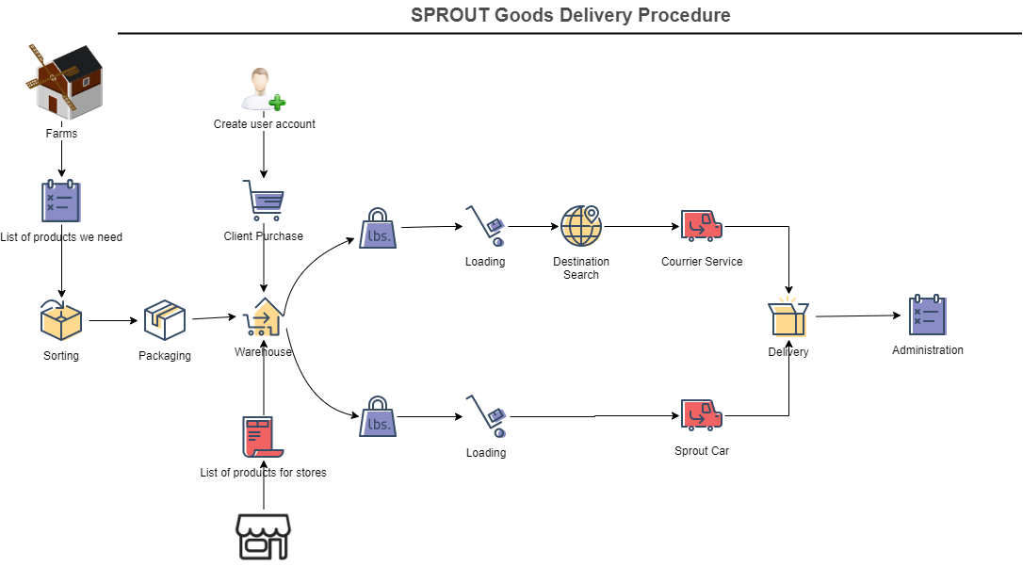
Logistics (Potential Expansion)
Insert diagram here

